Slide 1



GoldmanSachs
serviceExchange
By Rainbow and Unicorns

Slide 2



Significant Risk in Unregulated Industry
Increasing number of FinTech firms in Southeast Asia
Significant risk due to unregulated industry
Indonesia
Digital Wallet Solutions
Vietnam
No minimum overnight balance
Little to no insurance against service closure
Philippines

Slide 3



Introducing the GS Service Exchange
A Web-based Marketplace
Offers a comprehensive
list of solutions for
FinTech businesses
Sets the Gold Standard for FinTech businesses Worldwide
Increases Users’ trust
in FinTech businesses
Diverse Range of Services
Global Presence
Great Financial Position
Leveraging GS’ 153 years of experience in the Financial Industry
Notes:
With Goldman Sachs’ current array of digital banking services and longstanding history, we see this as an amazing opportunity for GS to enter the space as an industry gold standard. By having a marketplace of its open-banking services, with specific services tuned for fintech start ups, GS can helm the risk management of the industry, in turn creating value for itself, the industry, and most importantly, create safety for the millions of users across Southeast Asia.
Thus, our solution is to launch the GS serviceExchange, a web-based integrated marketplace for businesses to integrate their industry-standard services and monitor all transactions in one place.

Slide 4









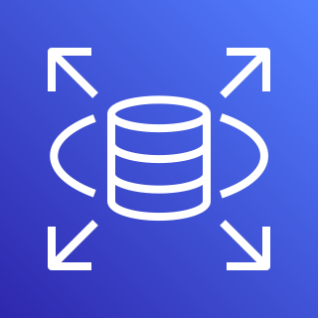


Architecting for Speed and Reliability
Vercel
User
Device
Vercel Edge Network (CDN)
Vercel Serverless Functions
AWS Cloud
Private subnet
Elastic Beanstalk container
Auto Scaling group
Amazon Elastic Compute Cloud (Amazon EC2)
Amazon Relational Database Service (Amazon RDS)
Elastic Load Balancing
.NET Backend

Slide 5

DEMO

Slide 6
Future Improvements
Third-Party Apps
Extending More Targeted Apps
Verified Third-Party Apps to increase traffic and encourage ecosystem adoption
Extend Marcus’ Digital Banking Accounts-as-a-Service
Further enhance GS’s share of the Southeast Asian Fintech Industry
Extendable and customizable Quantitative Finance APIs to herd risky trading strategies

Slide 7
Let’s spearhead the safest financial marketplace

Slide 8
References
Duncan, K. (2021, June 28). The secret to advanced fintech in Southeast Asia's poorest countries. Southeast Asia Globe. Retrieved August 26, 2022, from https://southeastasiaglobe.com/fintech-southeast-asia/
Fintech.coffee. (n.d.). 101 Indonesia based fintech companies: The most innovative companies. Fintech News for Your Coffee Break. Retrieved August 26, 2022, from https://www.fintech.coffee/research/101-indonesia
Privacy International. (2021, September 9). Perspectives on the harms of unregulated fintech. Privacy International. Retrieved August 26, 2022, from https://privacyinternational.org/long-read/4619/perspectives-harms-unregulated-fintech
Salesforce AppExchange: Leading Enterprise Cloud Marketplace. Salesforce AppExchange | Leading Enterprise Cloud Marketplace. (n.d.). Retrieved August 26, 2022, from https://appexchange.salesforce.com/
Thomson Reuters. (n.d.). Understanding the risks of Fintech. Thomson Reuters. Retrieved August 26, 2022, from https://legal.thomsonreuters.com/en/insights/articles/understanding-the-risks-of-fintech

